Slide 1
Results and lessons learned from the Students for Development program CBIE November 20, 2014

Slide 2
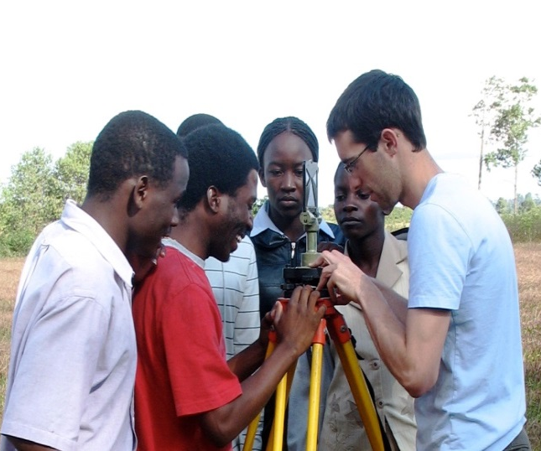
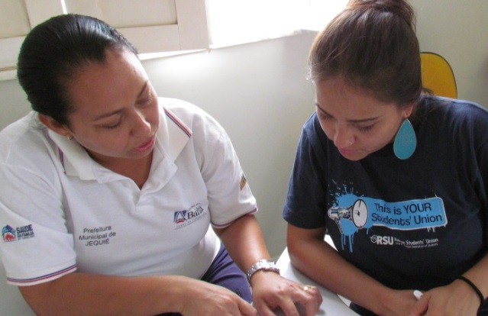
Overview
Impact on interns
Contributions to development
Lessons for designing new programs

Slide 3
Impact on interns
Skill sets
98% agreed (64% strongly) that the internship enabled them to develop skills from which they continue to benefit.

Slide 4
Impact on interns
Global fluency and leadership
96% agreed (63% strongly) that their internship enabled them to become more open and tolerant to other cultures.
96% agreed (49% strongly) that the internship had increased their ability and confidence to function in our increasingly interdependent world.
72% agreed (37% strongly) that their internship enabled them to establish professional connections which they continue to maintain.

Slide 5
Impact on interns
EMPLOYMENT (301 alumni) THE INTERNSHIP HELPED ME/WILL HELP ME: | Employed (147) | Still students (133)
Secure employment | 81% | 90%
Find a job related to my field of study | 66% | 85%
Obtain an international career | 63% | 90%
Obtain a job in international development | 52% | 82%

Slide 6
Contributions to development
Hosts
“The intern was able to make a positive contribution to the needs of our organization.” (952)
(on last day of internship):
Interns
“I was able to make a positive contribution to the needs of the host organization.”
(on last day of internship - 952):
(alumni survey – 301):

Slide 7
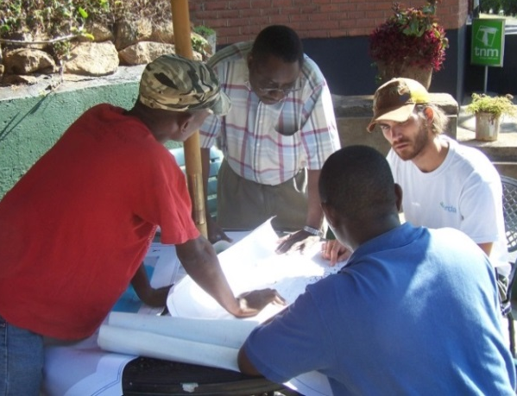
Contributions to development
Hosts said interns helped them:
Conduct research and develop policy reports and articles
Develop databases, websites and other IT tools
Organize and deliver workshops and training
Connect with other organizations domestically and internationally
Obtain new sources of funding and materials
Gain new perspectives on their work

Slide 8
Contributions to development

Slide 9
Lessons – statistical analysis
Factors that affect development outcomes:
intern’s age
intern’s level of study
intern’s gender
No effect on development outcomes:
calendar year of internship
intern’s academic program
intern’s satisfaction with preparation

Slide 10
Lessons for program design
Internships should be part of long-term partnerships projects
North-South partnerships are stronger when based on ongoing research, teaching and social engagement
Emphasize two-way flows of students and connect students in Canada and the global South
Encourage students from all programs and levels to participate
Provide funding and flexible programs where possible
Foster clear communications and manage expectations
Track outcomes over long term to demonstrate results

Slide 11
Thank you! Merci! For more information please contact: Philip Landon plandon@aucc.ca Claire Millington cmillington@aucc.ca

Slide 12
Questions
1. What are the perceptions on your campus of North-South student mobility? (Do you offer such programs, how are they rationalized?)
2. Share a really successful North-South student mobility experience. What factors contributed to the success?
3. What information/research could help your institution deliver better North-South mobility programs?

