Slide 1
Promising Practices in North-South Youth Internships IVCO October 21, 2014 Lima, Peru

Slide 2
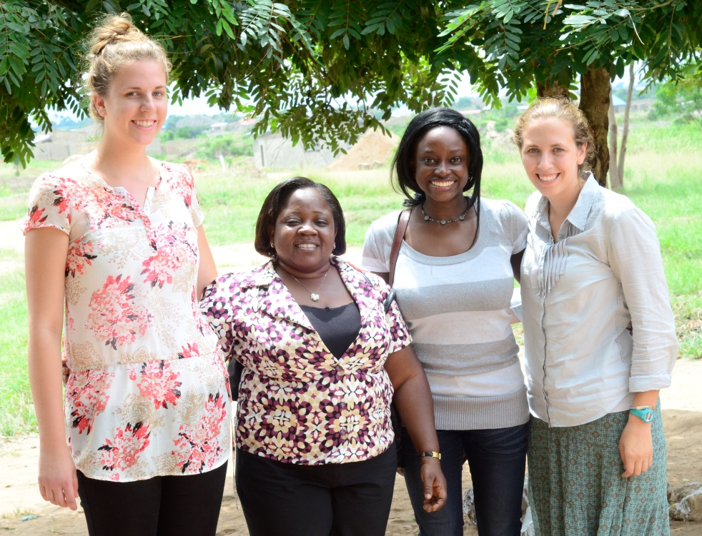
Overview
Background
Research findings
Recommendations
Next steps

Slide 3
Canadian student mobility context
While student mobility is a priority, most students are looking to conduct academic coursework abroad

Slide 4
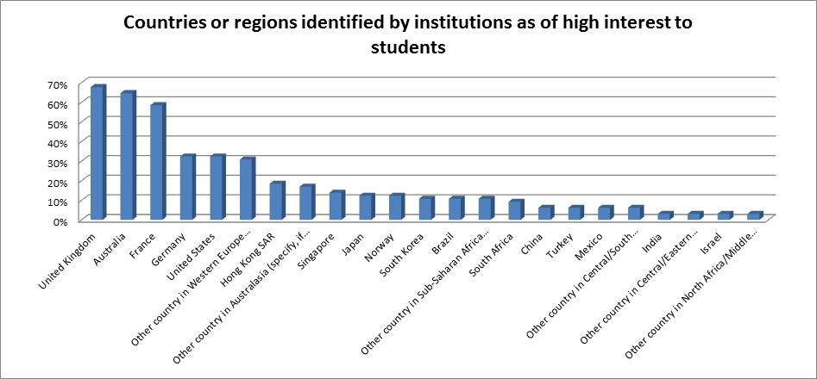
Developed/developing countries
Although internationalization is a priority for universities, most programs focus on developed countries

Slide 5
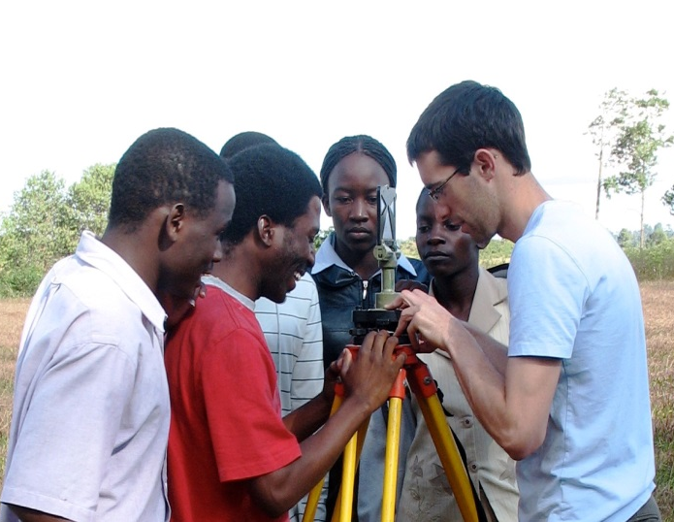
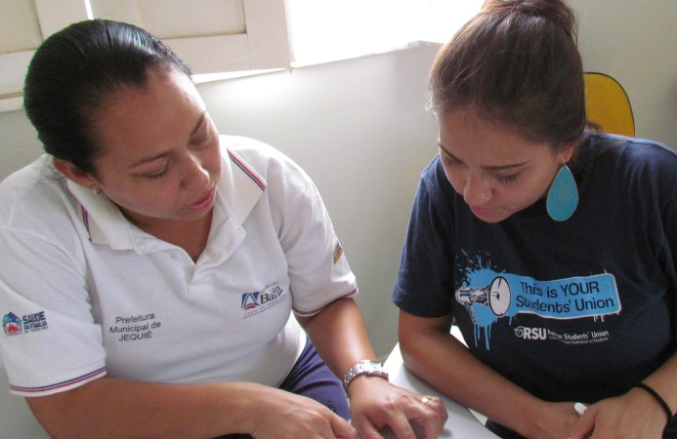
Research methodology and findings
Research questions
Did Students for Development Program (SFD) contribute to development?
What were the benefits and challenges for host organizations, students and universities?
What actions can be taken in future programs to maximize the benefits for all parties?
Data collection
Review of 952 questionnaires completed after each internship (2009-2013)
Survey of 2005-2012 alumni (301 resp. of 1,105)
Workshop with 27 Canadian university representatives
Interviews with 12 most active overseas hosts
2013 monitoring visits – 32 hosts, 70 interns, 6 uni reps

Slide 6
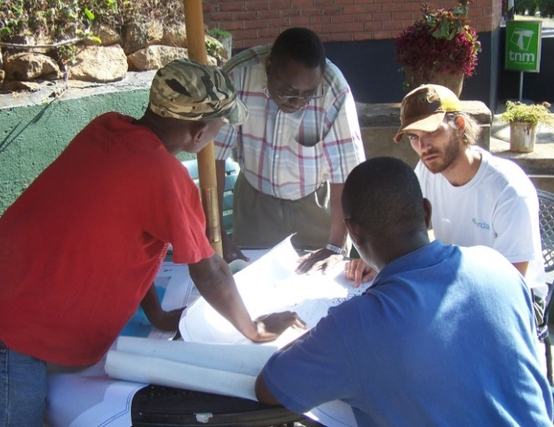
Contributions to development: Hosts
“The intern was able to make a positive contribution to the needs of our organization.” (952)
Host said interns helped them:
Conduct research and develop policy reports and articles
Develop databases, websites and other IT tools
Organize and deliver workshops and training
Connect with other organizations domestically and internationally
Obtain new sources of funding and materials
Gain new perspectives on their work

Slide 7
Challenges: Hosts

Slide 8
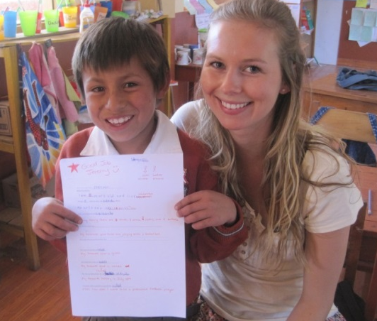
Contributions to development: Students
“I was able to make a positive contribution to the needs of the host organization.”
952 questionnaires
301 alumni surveys
Canadian interns said internships helped them:
Acquire new knowledge, skills, attitudes, and connections
Increase their commitment to development
Increase their employability, often in jobs related to
development

Slide 9
Contributions to development: Students

Slide 10
Challenges: Students

Slide 11
Contributions to development: Universities
“Overall the university is satisfied with the results of this internship.” (560)
Universities said SFD helped them to:
Inspire students to learn about and contribute to development, and in some cases pursue international careers
Lead multi-disciplinary teams on development projects
Link their research and teaching to development goals
Strengthen and expand their international partnerships (spin-off activities)
Attract international students to study in Canada

Slide 12
Challenges: Universities
Internships require considerable human/financial resources (at the expense of other activities)
Managing expectations and risks
Ensuring students complete reintegration activities
Facilitating processes for obtaining academic credits

Slide 13
Design Recommendations
Develop internships within multi-year projects
Encourage two-way internships and student connections
Program internships of longer than three months when possible
Provide appropriate funding for internships
Encourage stronger partnership between university and Southern partner based on links for ongoing research, teaching and social engagement
Foster clear communications among all parties, especially regarding objectives and expectations
Track outcomes over the long term

Slide 14
Next Steps
Continue research on understanding of best practices globally
Hold learning workshop in 2015/2016
Develop new internship programs

Slide 15
Thank you! Gracias! For more information please contact: Philip Landon plandon@aucc.ca Claire Millington cmillington@aucc.ca

